Slide 1
DATA SCIENCE Class 11: TYPES and Bases

Slide 2
I. Organizing Data II. formats III. APIs [LAB] IV. Databases V. SQL [LAB] [Lab]
agenda

Slide 3
I. Organizing Data
INTRO TO DATA SCIENCE

Slide 4
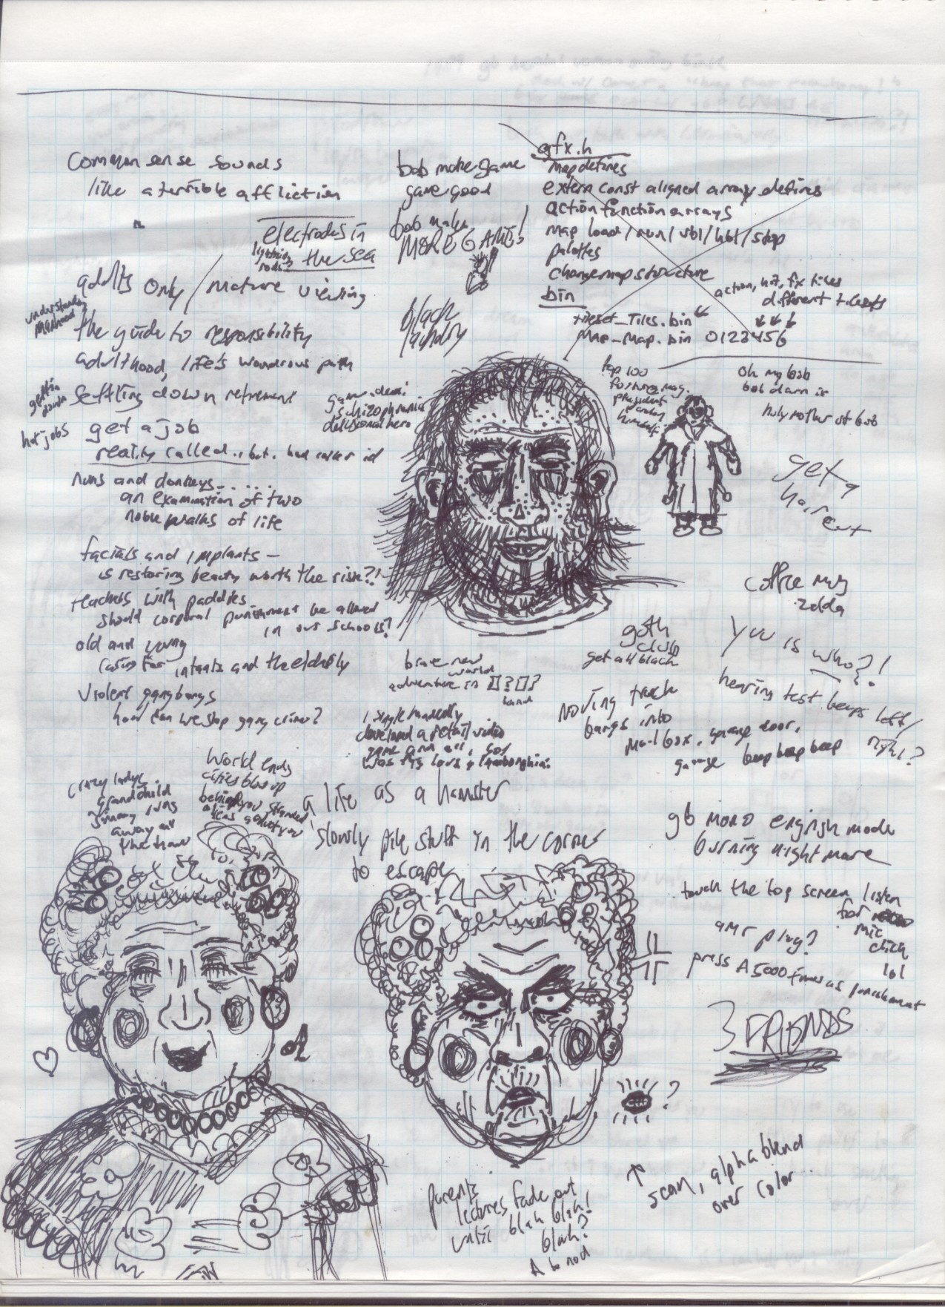
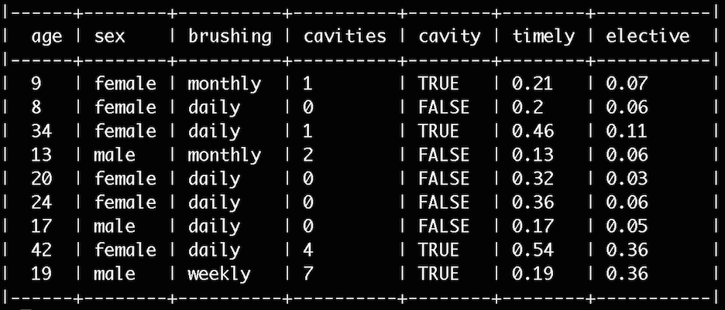
Organizing Data
Un-Structured Data
Structured Data
Notes:
Emphasize that this is a spectrum, not a binary classification.

Slide 5
Organizing Data
Tabular data
Nested data
Graph data

Slide 6
Organizing Data
Tabular data
Rows and columns
Implicit or explicit “schema”, tidy or not
Very common and well-handled by software

Slide 7
Organizing Data
“Tidy Data” is a conceptual framework for organizing data
Each variable is a column
Each observation is a row
Each type of observational unit is a table
Usually tabular; related to relational “normal forms”

Slide 8
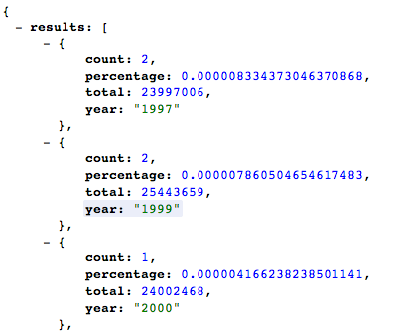
Organizing Data
Nested data
“Hierarchical”, “Tree”, “Object”
Often schema-less
Often multiple data types (lists, etc.)
Often natural and fairly common

Slide 9
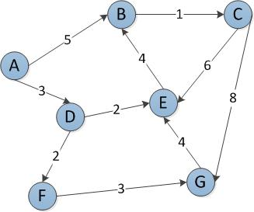
Organizing Data
Graph data
Nodes and Edges
Schema?
Fits particular applications, such as social networks and semantic web

Slide 10
II. Formats
INTRO TO DATA SCIENCE
Notes:
~15-20 min for this section?

Slide 11
Organizing Data
Tabular data
Nested data
Graph data

Slide 12
Organizing Data
Tabular data
Fixed-width text files: “ field007 blue” etc.
Delimited text files (Comma Separated Values and the much-ignored RFC 4180, plus tabs, pipes, and more)
Spreadsheets such as Excel
Database formats

Slide 13

Organizing Data
Tabular data
Fixed-width text files: “ field007 blue” etc.
Delimited text files (Comma Separated Values and the much-ignored RFC 4180, plus tabs, pipes, and more)
Spreadsheets such as Excel
Database formats
“FLAT FILES”
Plain text files that hold data (fixed width and delimited text files, typically) are often referred to as “flat files”.

Slide 14
Organizing Data
Tabular data
Fixed-width text files: “ field007 blue” etc.
Delimited text files (Comma Separated Values and the much-ignored RFC 4180, plus tabs, pipes, and more)
Spreadsheets such as Excel
Database formats
“FLAT FILES”
ONE MORE THING!
Plain text files that hold data (fixed width and delimited text files, typically) are often referred to as “flat files”.
We might include matrix formats, images, and perhaps even more here. (They could also be considered separately.)

Slide 15
Organizing Data
Nested data
Extensible Markup Notation (XML)
JavaScript Object Notation (JSON)
Other serialization systems such as Apache Thrift and Avro, and Google Protocol Buffers – even just pickled Python objects

Slide 16
Organizing Data
Graph data
Various formats, built on lower-level formats.

Slide 17
III. APIs [Lab]
INTRO TO DATA SCIENCE
Notes:
~15-20 min for this section?

Slide 18
IV. Databases
INTRO TO DATA SCIENCE
Notes:
~15-20 min for this section?

Slide 19
Organizing Data
Tabular data
Nested data
Graph data

Slide 20
Organizing Data
Tabular data
Relational DataBase Management Systems (RDBMS) – broadly implementing SQL
Serverless/embedded: SQLite, H2, etc.
Client-Server: MySQL/MariaDB, PostgreSQL, Oracle, MSSQL, etc.

Slide 21
Organizing Data
Nested data
Document stores: MongoDB, CouchDB, etc.
Serialization schemes, often on HDFS
Key-value stores: Redis, Voldemort, etc.
Blurred Lines: Object-Relational Mapping, Cassandra, column orientation, etc.
Notes:
Voldemort is used by LinkedIn

Slide 22
Organizing Data
Graph data
Client-server (general): Neo4j, perhaps more
Client-server (triple store): AllegroGraph, etc.
Query languages: SPARQL, RDF++, Prolog…

Slide 23
V. SQL [Lab] [Lab]
INTRO TO DATA SCIENCE
Notes:
~15-20 min for this section?

Slide 24
INTRO TO DATA SCIENCE

